Slide 1
Artificial Intelligence Problem solving by searching

Slide 2
Outline
Problem formulation
Example problems
Basic search algorithms

Slide 3
Example: Romania
On holiday in Romania; currently in Arad.
Flight leaves tomorrow from Bucharest
Formulate goal:
be in Bucharest
Formulate problem:
states: various cities
actions: drive between cities
Find solution:
sequence of cities, e.g., Arad, Sibiu, Fagaras, Bucharest

Slide 4
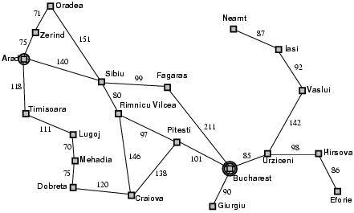
Example: Romania

Slide 5
Problem types
Deterministic, fully observable → single-state problem
Agent knows exactly which state it will be in; solution is a sequence
Non-observable → sensorless problem (conformant problem)
Agent may have no idea where it is; solution is a sequence
Nondeterministic and/or partially observable → contingency problem
percepts provide new information about current state
often interleave} search, execution
Unknown state space → exploration problem

Slide 6
Search Methods
Once we have defined the problem space (state representation, the initial state, the goal state and operators) is all done?
Let’s consider the River Problem:
A farmer wishes to carry a wolf, a duck and corn across a river, from the south to the north shore. The farmer is the proud owner of a small rowing boat called Bounty which he feels is easily up to the job. Unfortunately the boat is only large enough to carry at most the farmer and one other item. Worse again, if left unattended the wolf will eat the duck and the duck will eat the corn.
How can the farmer safely transport the wolf, the duck and the corn to the opposite shore?
River
boat
Farmer, Wolf,
Duck and Corn

Slide 7
Search Methods
The River Problem:
F=Farmer W=Wolf D=Duck C=Corn /=River
How can the farmer safely transport the wolf, the duck and the corn to the opposite shore?
-/FWCD
FWCD/-

Slide 8
Search Methods
Problem formulation:
State representation: location of farmer and items in both sides of river
[items in South shore / items in North shore] : (FWDC/-, FD/WC, C/FWD …)
Initial State: farmer, wolf, duck and corn in the south shore FWDC/-
Goal State: farmer, duck and corn in the north shore
-/FWDC
Operators: the farmer takes in the boat at most one item from one side to the other side
(F-Takes-W, F-Takes-D, F-Takes-C, F-Takes-Self [himself only])
Path cost: the number of crossings

Slide 9
Search Methods
State space:
A problem is solved by moving from the initial state to the goal state by applying valid operators in sequence. Thus the state space is the set of states reachable from a particular initial state.
Initial state
Dead ends
Illegal states
repeated state
intermediate state
Goal state

Slide 10
Search Methods
Searching for a solution:
We start with the initial state and keep using the operators to expand the parent nodes till we find a goal state.
…but the search space might be large…
…really large…
So we need some systematic way to search.

Slide 11
Search Methods
Problem solution:
A problem solution is simply the set of operators (actions) needed to reach the goal state from the initial state:
F-Takes-D, F-Takes-Self, F-Takes-W,
F-Takes-D, F-Takes-C, F-Takes-Self,
F-Takes-D.

Slide 12
Search Methods
Problem solution: (path Cost = 7)
While there are other possibilities here is one 7 step solution to the river problem
F
D
D
F
W
D
F-Takes-D
F-Takes-S
F-Takes-W
F
W
D
C
W
C
F
W
C
C
Initial State
WC/FD
FWC/D
C/FWD
F-Takes-D
F
W
G
C
W
C
F
W
C
W
F-Takes-D
F-Takes-S
F-Takes-C
F
D
D
F
D
C
Goal State
FD/WC
D/FWC
FDC/W

Slide 13
Problem Solving by searching
Basic Search Algorithms

Slide 14
Basic Search Algorithms
uninformed( Blind) search: breadth-first, depth-first, depth limited, iterative deepening, and bidirectional search
informed (Heuristic) search: search is guided by an evaluation function: Greedy best-first, A*, IDA*, and beam search
optimization in which the search is to find an optimal value of an objective function: hill climbing, simulated annealing, genetic algorithms, Ant Colony Optimization
Game playing, an adversarial search: minimax algorithm, alpha-beta pruning

Slide 15
What Criteria are used to Compare different search techniques ?
As we are going to consider different techniques to search the problem space, we need to consider what criteria we will use to compare them.
Completeness: Is the technique guaranteed to find an answer (if there is one).
Optimality/Admissibility : does it always find a least-cost solution?
- an admissible algorithm will find a solution with minimum cost
Time Complexity: How long does it take to find a solution.
Space Complexity: How much memory does it take to find a solution.

Slide 16
Time and Space Complexity ?
Time and space complexity are measured in terms of:
The average number of new nodes we create when expanding a new node is the (effective) branching factor b.
The (maximum) branching factor b is defined as the maximum nodes created when a new node is expanded.
The length of a path to a goal is the depth d.
The maximum length of any path in the state space m.

Slide 17
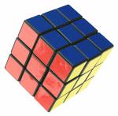
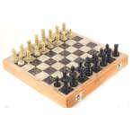
Branching factors for some problems
The eight puzzle has a (effective) branching factor of 2.13, so a search tree at depth 20 has about 3.7 million nodes: O(b^{d})
Rubik’s cube has a (effective) branching factor of 13.34. There are 901,083,404,981,813,616 different states. The average depth of a solution is about 18.
Chess has a branching factor of about 35, there are about 10¹²⁰ states (there are about 10⁷⁹ electrons in the universe).
2
1
3
4
7
6
5
8

Slide 18
Example: A Romanian Holiday
State space: Cities in Romania
Initial state: Town of Arad
Goal: Airport in Bucharest
Operators: Drive between cities
Solution: Sequence of cities
Path cost: number of cities, distance, time, fuel

Slide 19
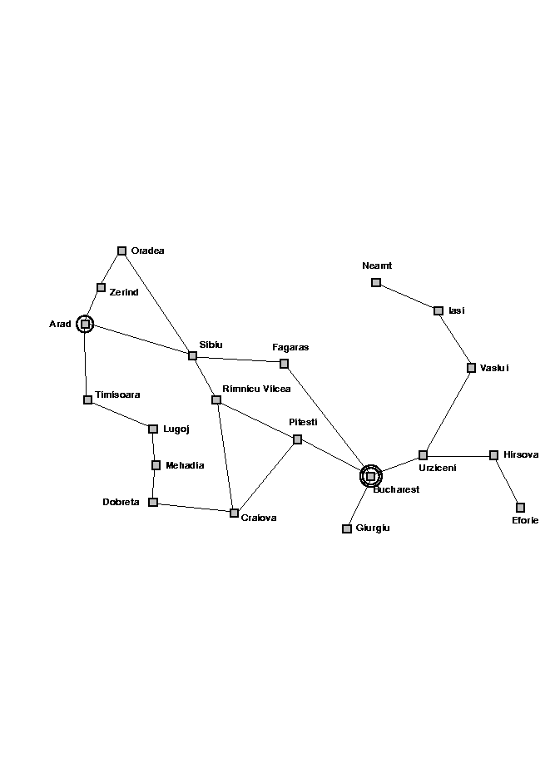
The state Space

Slide 20
Generic Search Algorithms
Basic Idea: Off-line exploration of state space by generating successors of already-explored states (also known as expanding states).
Function GENERAL-SEARCH (problem, strategy)
returns a solution or failure
Initialize the search tree using the initial state of problem
loop do
if there are no candidates for expansion, then return failure
Choose a leaf node for expansion according to strategy
if node contains goal state then return solution
else expand node and add resulting nodes to search tree.
end

Slide 21
Representing Search
Arad
Zerind
Sibiu
Timisoara
Arad
Oradea
Fagaras
Rimnicu Vilcea
Sibiu
Bucharest

Slide 22

Solution

Slide 23
Implementation of Generic Search Algorithm
function general-search(problem, QUEUEING-FUNCTION)
nodes = MAKE-QUEUE(MAKE-NODE(problem.INITIAL-STATE))
loop do
if EMPTY(nodes) then return "failure"
node = REMOVE-FRONT(nodes)
if problem.GOAL-TEST(node.STATE) succeeds then return solution(node)
nodes = QUEUEING-FUNCTION(nodes, EXPAND(node, problem.OPERATORS))
end
A nice fact about this search algorithm is that we can use a single algorithm to do many kinds of search. The only difference is in how the nodes are placed in the queue. The choice of queuing function is the main feature.

Slide 24
Key Issues of State-Space search algorithm
Search process constructs a “search tree”
root is the start node
leaf nodes are:
unexpanded nodes (in the nodes list)
“dead ends” (nodes that aren’t goals and have no successors because no operators were applicable)
Loops in a graph may cause a “search tree” to be infinite even if the state space is small
changing definition of how nodes are added to list leads to a different search strategy
Solution desired may be:
just the goal state
a path from start to goal state (e.g., 8-puzzle)

Slide 25
Uninformed search strategies (Blind search)
Uninformed (blind) strategies use only the information available in the problem definition. These strategies order nodes without using any domain specific information
Contrary to Informed search techniques which might have additional information (e.g. a compass).
Breadth-first search
Uniform-cost search
Depth-first search
Depth-limited search
Iterative deepening search
Bidirectional search

Slide 26
Basic Search Algorithms Uninformed Search
Breadth First Search (BFS)

Slide 27
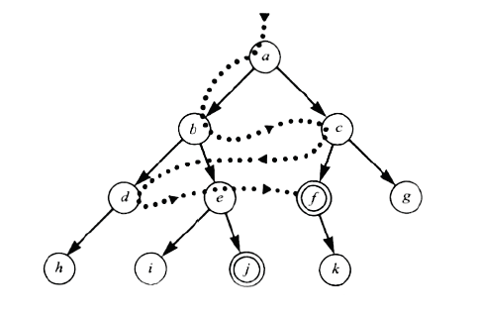
Breadth First Search (BFS)

Slide 28
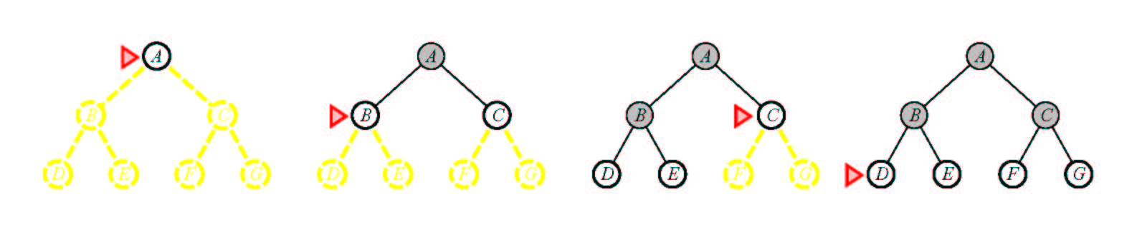
Breadth First Search (BFS)
Main idea: Expand all nodes at depth (i) before expanding nodes at depth (i + 1)
Level-order Traversal.
Implementation: Use of a First-In-First-Out queue (FIFO). Nodes visited first are expanded first. Enqueue nodes in FIFO (first-in, first-out) order.
Complete? Yes.
Optimal? Yes, if path cost is nondecreasing function of depth
Time Complexity: O(b^{d})
Space Complexity: O(b^{d}), note that every node in the fringe is kept in the queue.

Slide 29
Breadth First Search
QUEUING-FN:- successors added to end of queue
Arad
Zerind
Sibiu
Timisoara
Arad
Oradea
Fagaras
Arad
Oradea
Arad
Lugoj
Rimnicu Vilcea
Shallow nodes are expanded before deeper nodes.

Slide 30
Basic Search Algorithms Uninformed Search
Uniform Cost Search (UCS)

Slide 31
Uniform Cost Search (UCS)
5
2
[5]
[2]
1
4
1
7
[6]
[3]
[9]
[9]
Goal state
4
5
[x] = g(n)
path cost of node n
[7]
[8]

Slide 32
Uniform Cost Search (UCS)
5
2
[5]
[2]

Slide 33
Uniform Cost Search (UCS)
5
2
[5]
[2]
1
7
[3]
[9]

Slide 34
Uniform Cost Search (UCS)
5
2
[5]
[2]
1
7
[3]
[9]
4
5
[7]
[8]

Slide 35
Uniform Cost Search (UCS)
5
2
[5]
[2]
1
4
1
7
[6]
[3]
[9]
[9]
4
5
[7]
[8]

Slide 36
Uniform Cost Search (UCS)
5
2
[5]
[2]
Goal state path cost g(n)=[6]
1
4
1
7
[3]
[9]
[9]
4
5
[7]
[8]

Slide 37
Uniform Cost Search (UCS)
5
2
[5]
[2]
1
4
1
7
[6]
[3]
[9]
[9]
4
5
[7]
[8]

Slide 38
Uniform Cost Search (UCS)
In case of equal step costs, Breadth First search finds the optimal solution.
For any step-cost function, Uniform Cost search expands the node n with the lowest path cost.
UCS takes into account the total cost: g(n).
UCS is guided by path costs rather than depths. Nodes are ordered according to their path cost.

Slide 39
Uniform Cost Search (UCS)
Main idea: Expand the cheapest node. Where the cost is the path cost g(n).
Implementation:
Enqueue nodes in order of cost g(n).
QUEUING-FN:- insert in order of increasing path cost.
Enqueue new node at the appropriate position in the queue so that we dequeue the cheapest node.
Complete? Yes.
Optimal? Yes, if path cost is nondecreasing function of depth
Time Complexity: O(b^{d})
Space Complexity: O(b^{d}), note that every node in the fringe keep in the queue.

Slide 40
Basic Search Algorithms Uninformed Search
Depth First Search (DFS)

Slide 41
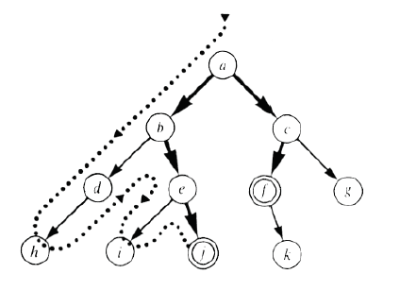
Depth First Search (DFS)

Slide 42
Depth First Search (DFS)
Main idea: Expand node at the deepest level (breaking ties left to right).
Implementation: use of a Last-In-First-Out queue or stack(LIFO). Enqueue nodes in LIFO (last-in, first-out) order.
Complete? No (Yes on finite trees, with no loops).
Optimal? No
Time Complexity: O(b^{m}), where m is the maximum depth.
Space Complexity: O(bm), where m is the maximum depth.

Slide 43
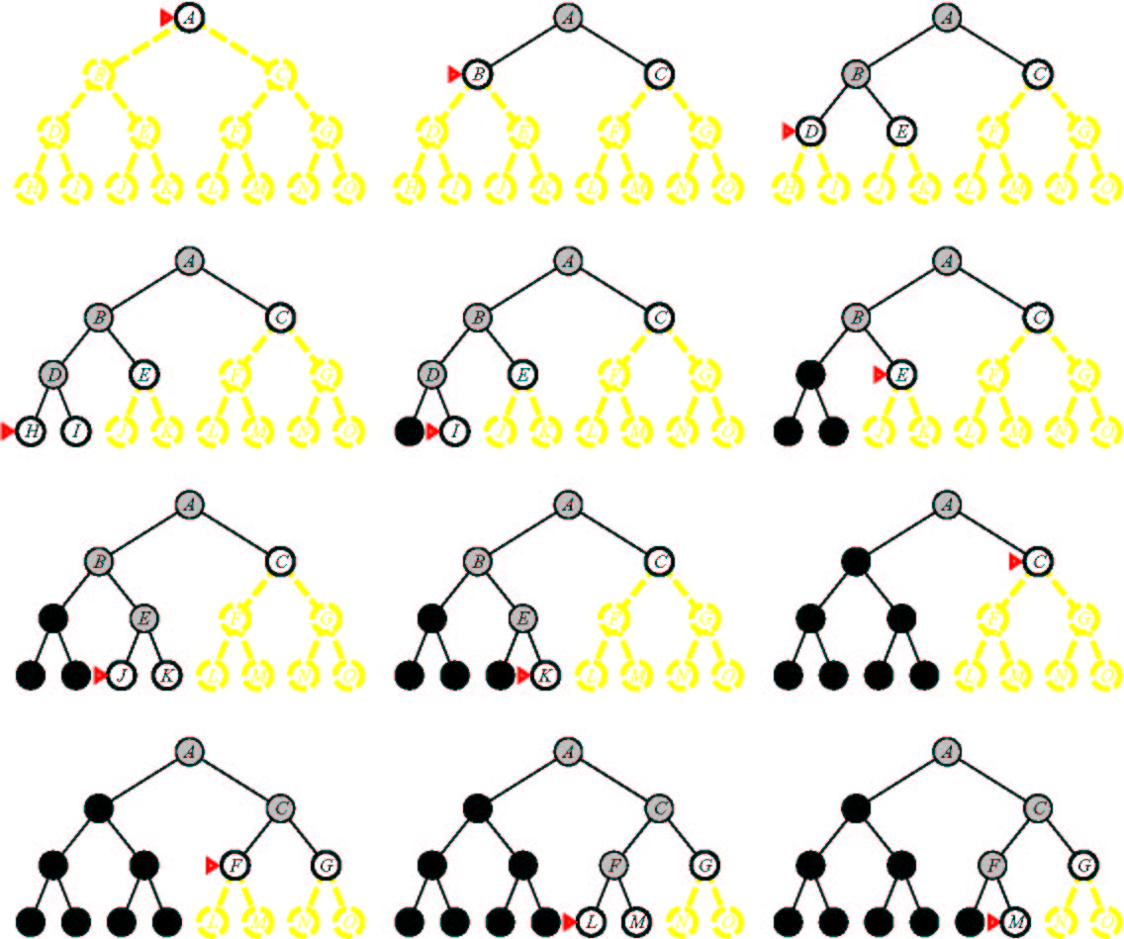
Depth First Search

Slide 44
Depth-First Search (DFS)
QUEUING-FN:- insert successors at front of queue
Arad
Zerind
Sibiu
Timisoara
Arad
Oradea
Zerind
Sibiu
Timisoara

Slide 45
Basic Search Algorithms Uninformed Search
Depth-Limited Search (DLS)

Slide 46

Depth-Limited Search (DLS)
Depth Bound = 3

Slide 47
Depth-Limited Search (DLS)
It is simply DFS with a depth bound.
Searching is not permitted beyond the depth bound.
Works well if we know what the depth of the solution is.
Termination is guaranteed.
If the solution is beneath the depth bound, the search cannot find the goal (hence this search algorithm is incomplete).
Otherwise use Iterative deepening search (IDS).

Slide 48
Depth-Limited Search (DLS)
Main idea: Expand node at the deepest level, but limit depth to L.
Implementation:
Enqueue nodes in LIFO (last-in, first-out) order. But limit depth to L
Complete? Yes if there is a goal state at a depth less than L
Optimal? No
Time Complexity: O(b^{L}), where L is the cutoff.
Space Complexity: O(bL), where L is the cutoff.

Slide 49
Basic Search Algorithms Uninformed Search
Iterative Deepening Search (IDS)

Slide 50
Iterative Deepening Search (IDS)
function ITERATIVE-DEEPENING-SEARCH():
for depth = 0 to infinity do
if DEPTH-LIMITED-SEARCH(depth) succeeds
then return its result
end
return failure

Slide 51
Iterative Deepening Search (IDS)
Key idea: Iterative deepening search (IDS) applies DLS repeatedly with increasing depth. It terminates when a solution is found or no solutions exists.
IDS combines the benefits of BFS and DFS: Like DFS the memory requirements are very modest (O(bd)). Like BFS, it is complete when the branching factor is finite.
The total number of generated nodes is :
N(IDS)=(d)b + (d-1) b² + …+(1)b^{d}
In general, iterative deepening is the preferred uninformed search method when there is a large search space and the depth of the solution is not known.

Slide 52
Iterative Deepening Search (IDS)
L = 0
L = 1
L = 2
L = 3

Slide 53
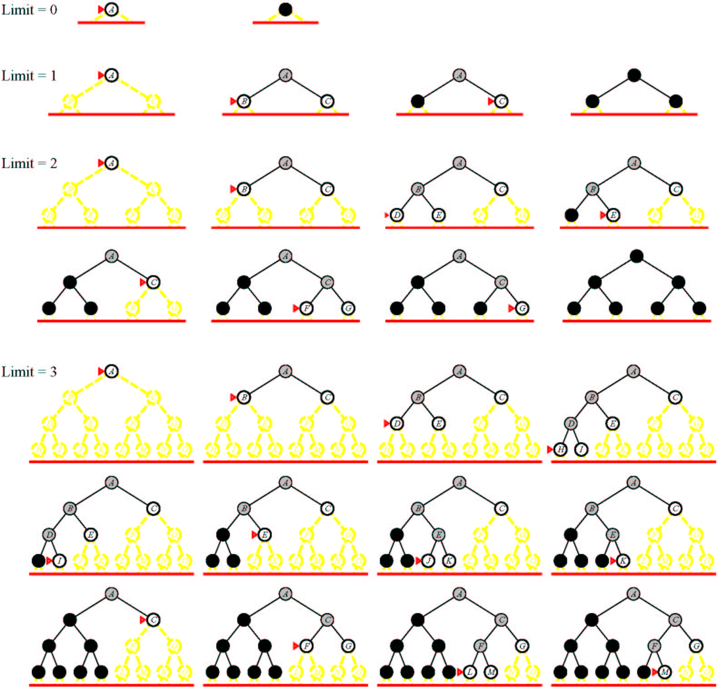
Iterative Deepening Search (IDS)

Slide 54
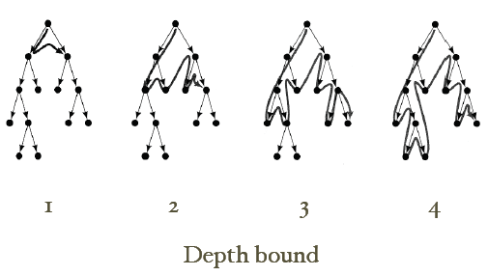
Iterative Deepening Search (IDS)

Slide 55
Basic Search Algorithms Uninformed Search
Bi-Directional Search (BDS)

Slide 56
Bi-directional Search (BDS)
Main idea: Start searching from both the initial state and the goal state, meet in the middle.
Complete? Yes
Optimal? Yes
Time Complexity: O(b^{d/2}), where d is the depth of the solution.
Space Complexity: O(b^{d/2}), where d is the depth of the solution.

Slide 57
Basic Search Algorithms
Comparison of search algorithms

Slide 58
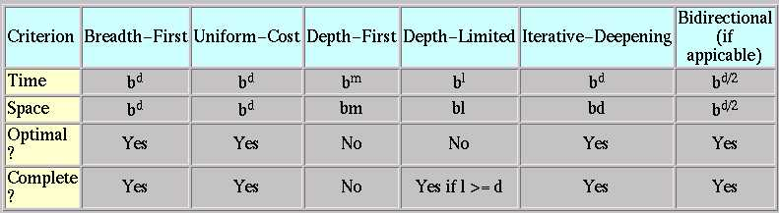
Comparison of search algorithms
b: Branching factor
d: Depth of solution
m: Maximum depth
l : Depth Limit

Slide 59
Blind Search Algorithms
Tree Search:
BFS, DFS, DLS, IDS

Slide 60
Basic Search Algorithms
Breadth First Search
BFS

Slide 61
Breadth First Search
Application1:
Given the following state space (tree search), give the sequence of visited nodes when using BFS (assume that the nodeO is the goal state):
A
B
C
D
E
F
G
H
I
J
K
L
M
N
O

Slide 62
Breadth First Search
A,
A
B
C
D
E

Slide 63
Breadth First Search
A,
B,
A
B
C
D
E
F
G

Slide 64
Breadth First Search
A,
B,C
A
B
C
D
E
F
G
H

Slide 65
Breadth First Search
A,
B,C,D
A
B
C
D
E
F
G
H
I
J

Slide 66
Breadth First Search
A,
B,C,D,E
A
B
C
D
E
F
G
H
I
J

Slide 67
Breadth First Search
A,
B,C,D,E,
F,
A
B
C
D
E
F
G
H
I
J

Slide 68
Breadth First Search
A,
B,C,D,E,
F,G
A
B
C
D
E
F
G
H
I
J
K
L

Slide 69
Breadth First Search
A,
B,C,D,E,
F,G,H
A
B
C
D
E
F
G
H
I
J
K
L

Slide 70
Breadth First Search
A,
B,C,D,E,
F,G,H,I
A
B
C
D
E
F
G
H
I
J
K
L
M

Slide 71
Breadth First Search
A,
B,C,D,E,
F,G,H,I,J,
A
B
C
D
E
F
G
H
I
J
K
L
M
N

Slide 72
Breadth First Search
A,
B,C,D,E,
F,G,H,I,J,
K,
A
B
C
D
E
F
G
H
I
J
K
L
M
N

Slide 73
Breadth First Search
A,
B,C,D,E,
F,G,H,I,J,
K,L
A
B
C
D
E
F
G
H
I
J
K
L
M
N
O

Slide 74
Breadth First Search
A,
B,C,D,E,
F,G,H,I,J,
K,L, M,
A
B
C
D
E
F
G
H
I
J
K
L
M
N
O

Slide 75
Breadth First Search
A,
B,C,D,E,
F,G,H,I,J,
K,L, M,N,
A
B
C
D
E
F
G
H
I
J
K
L
M
N
O

Slide 76
Breadth First Search
A,
B,C,D,E,
F,G,H,I,J,
K,L, M,N,
Goal state: O
A
B
C
D
E
F
G
H
I
J
K
L
M
N
O

Slide 77
Breadth First Search
The returned solution is the sequence of operators in the path:
A, B, G, L, O
A
B
C
D
E
F
G
H
I
J
K
L
M
N
O

Slide 78
Basic Search Algorithms
Depth First Search
DFS

Slide 79
Depth First Search (DFS)
Application2:
Given the following state space (tree search), give the sequence of visited nodes when using DFS (assume that the nodeO is the goal state):
A
B
C
D
E
F
G
H
I
J
K
L
M
N
O

Slide 80
Depth First Search
A,
A
B
C
D
E

Slide 81
Depth First Search
A,B,
A
B
C
D
E
F
G

Slide 82
Depth First Search
A,B,F,
A
B
C
D
E
F
G

Slide 83
Depth First Search
A,B,F,
G,
A
B
C
D
E
F
G
K
L

Slide 84
Depth First Search
A,B,F,
G,K,
A
B
C
D
E
F
G
K
L

Slide 85
Depth First Search
A,B,F,
G,K,
L,
A
B
C
D
E
F
G
K
L
O

Slide 86
Depth First Search
A,B,F,
G,K,
L, O: Goal State
A
B
C
D
E
F
G
K
L
O

Slide 87
Depth First Search
The returned solution is the sequence of operators in the path: A, B, G, L, O
A
B
C
D
E
F
G
K
L
O

Slide 88
Basic Search Algorithms
Depth-Limited Search
DLS

Slide 89
Depth-Limited Search (DLS)
Application3:
Given the following state space (tree search), give the sequence of visited nodes when using DLS (Limit = 2):
Limit = 0
A
Limit = 1
B
C
D
E
Limit = 2
F
G
H
I
J
K
L
M
N
O

Slide 90
Depth-Limited Search (DLS)
A,
A
B
C
D
E
Limit = 2

Slide 91
Depth-Limited Search (DLS)
A,B,
A
B
C
D
E
Limit = 2
F
G

Slide 92
Depth-Limited Search (DLS)
A,B,F,
A
B
C
D
E
Limit = 2
F
G

Slide 93
Depth-Limited Search (DLS)
A,B,F,
G,
A
B
C
D
E
Limit = 2
F
G

Slide 94
Depth-Limited Search (DLS)
A,B,F,
G,
C,
A
B
C
D
E
Limit = 2
F
G
H

Slide 95
Depth-Limited Search (DLS)
A,B,F,
G,
C,H,
A
B
C
D
E
Limit = 2
F
G
H

Slide 96
Depth-Limited Search (DLS)
A,B,F,
G,
C,H,
D,
A
B
C
D
E
Limit = 2
F
G
H
I
J

Slide 97
Depth-Limited Search (DLS)
A,B,F,
G,
C,H,
D,I
A
B
C
D
E
Limit = 2
F
G
H
I
J

Slide 98
Depth-Limited Search (DLS)
A,B,F,
G,
C,H,
D,I
J,
A
B
C
D
E
Limit = 2
F
G
H
I
J

Slide 99
Depth-Limited Search (DLS)
A,B,F,
G,
C,H,
D,I
J,
E
A
B
C
D
E
Limit = 2
F
G
H
I
J

Slide 100
Depth-Limited Search (DLS)
A,B,F,
G,
C,H,
D,I
J,
E, Failure
A
B
C
D
E
Limit = 2
F
G
H
I
J

Slide 101
Depth-Limited Search (DLS)
DLS algorithm returns Failure (no solution)
The reason is that the goal is beyond the limit (Limit =2): the goal depth is (d=4)
A
B
C
D
E
Limit = 2
F
G
H
I
J
K
L
M
N
O

Slide 102
Basic Search Algorithms
Iterative Deepening Search
IDS

Slide 103
Iterative Deepening Search (IDS)
Application4:
Given the following state space (tree search), give the sequence of visited nodes when using IDS:
Limit = 0
A
Limit = 1
B
C
D
E
Limit = 2
F
G
H
I
J
Limit = 3
K
L
M
N
Limit = 4
O

Slide 104
Iterative Deepening Search (IDS)
DLS with bound = 0

Slide 105
Iterative Deepening Search (IDS)
A,
Limit = 0
A

Slide 106
Iterative Deepening Search (IDS)
A, Failure
Limit = 0
A

Slide 107
Iterative Deepening Search (IDS)
DLS with bound = 1

Slide 108
Iterative Deepening Search (IDS)
A,
A
Limit = 1
B
C
D
E

Slide 109
Iterative Deepening Search (IDS)
A,B,
A
Limit = 1
B
C
D
E

Slide 110
Iterative Deepening Search (IDS)
A,B,
C,
A
Limit = 1
B
C
D
E

Slide 111
Iterative Deepening Search (IDS)
A,B,
C,
D,
A
Limit = 1
B
C
D
E

Slide 112
Iterative Deepening Search (IDS)
A,B
C,
D,
E,
A
Limit = 1
B
C
D
E

Slide 113
Iterative Deepening Search (IDS)
A,B,
C,
D,
E, Failure
A
Limit = 1
B
C
D
E

Slide 114
Iterative Deepening Search (IDS)
A,
A
B
C
D
E
Limit = 2

Slide 115
Iterative Deepening Search (IDS)
A,B,
A
B
C
D
E
Limit = 2
F
G

Slide 116
Iterative Deepening Search (IDS)
A,B,F,
A
B
C
D
E
Limit = 2
F
G

Slide 117
Iterative Deepening Search (IDS)
A,B,F,
G,
A
B
C
D
E
Limit = 2
F
G

Slide 118
Iterative Deepening Search (IDS)
A,B,F,
G,
C,
A
B
C
D
E
Limit = 2
F
G
H

Slide 119
Iterative Deepening Search (IDS)
A,B,F,
G,
C,H,
A
B
C
D
E
Limit = 2
F
G
H

Slide 120
Iterative Deepening Search (IDS)
A,B,F,
G,
C,H,
D,
A
B
C
D
E
Limit = 2
F
G
H
I
J

Slide 121
Iterative Deepening Search (IDS)
A,B,F,
G,
C,H,
D,I
A
B
C
D
E
Limit = 2
F
G
H
I
J

Slide 122
Iterative Deepening Search (IDS)
A,B,F,
G,
C,H,
D,I
J,
A
B
C
D
E
Limit = 2
F
G
H
I
J

Slide 123
Iterative Deepening Search (IDS)
A,B,F,
G,
C,H,
D,I
J,
E
A
B
C
D
E
Limit = 2
F
G
H
I
J

Slide 124
Iterative Deepening Search (IDS)
A,B,F,
G,
C,H,
D,I
J,
E, Failure
A
B
C
D
E
Limit = 2
F
G
H
I
J
K
L
M
N
O

Slide 125
Iterative Deepening Search (IDS)
DLS with bound = 3

Slide 126
Iterative Deepening Search (IDS)
A,
A
B
C
D
E
Limit = 3

Slide 127
Iterative Deepening Search (IDS)
A,B,
A
B
C
D
E
F
G
Limit = 3

Slide 128
Iterative Deepening Search (IDS)
A,B,F,
A
B
C
D
E
F
G
Limit = 3

Slide 129
Iterative Deepening Search (IDS)
A,B,F,
G,
A
B
C
D
E
F
G
Limit = 3
K
L

Slide 130
Iterative Deepening Search (IDS)
A,B,F,
G,K,
A
B
C
D
E
F
G
Limit = 3
K
L

Slide 131
Iterative Deepening Search (IDS)
A,B,F,
G,K,
L,
A
B
C
D
E
F
G
Limit = 3
K
L

Slide 132
Iterative Deepening Search (IDS)
A,B,F,
G,K,
L,
C,
A
B
C
D
E
F
G
H
Limit = 3
K
L

Slide 133
Iterative Deepening Search (IDS)
A,B,F,
G,K,
L,
C,H,
A
B
C
D
E
F
G
H
Limit = 3
K
L

Slide 134
Iterative Deepening Search (IDS)
A,B,F,
G,K,
L,
C,H,
D,
A
B
C
D
E
F
G
H
I
J
Limit = 3
K
L

Slide 135
Iterative Deepening Search (IDS)
A,B,F,
G,K,
L,
C,H,
D,I,
A
B
C
D
E
F
G
H
I
J
Limit = 3
K
L
M

Slide 136
Iterative Deepening Search (IDS)
A,B,F,
G,K,
L,
C,H,
D,I,M,
A
B
C
D
E
F
G
H
I
J
Limit = 3
K
L
M

Slide 137
Iterative Deepening Search (IDS)
A,B,F,
G,K,
L,
C,H,
D,I,M,
J,
A
B
C
D
E
F
G
H
I
J
Limit = 3
K
L
M
N

Slide 138
Iterative Deepening Search (IDS)
A,B,F,
G,K,
L,
C,H,
D,I,M,
J,N,
A
B
C
D
E
F
G
H
I
J
Limit = 3
K
L
M
N

Slide 139
Iterative Deepening Search (IDS)
A,B,F,
G,K,
L,
C,H,
D,I,M,
J,N,
E,
A
B
C
D
E
F
G
H
I
J
Limit = 3
K
L
M
N

Slide 140
Iterative Deepening Search (IDS)
A,B,F,
G,K,
L,
C,H,
D,I,M,
J,N,
E,Failure
A
B
C
D
E
F
G
H
I
J
Limit = 3
K
L
M
N
O

Slide 141
Iterative Deepening Search (IDS)
DLS with bound = 4

Slide 142
Iterative Deepening Search (IDS)
A,
A
B
C
D
E
Limit = 4

Slide 143
Iterative Deepening Search (IDS)
A,B,
A
B
C
D
E
F
G
Limit = 4

Slide 144
Iterative Deepening Search (IDS)
A,B,F,
A
B
C
D
E
F
G
Limit = 4

Slide 145
Iterative Deepening Search (IDS)
A,B,F,
G,
A
B
C
D
E
F
G
K
L
Limit = 4

Slide 146
Iterative Deepening Search (IDS)
A,B,F,
G,K,
A
B
C
D
E
F
G
K
L
Limit = 4

Slide 147
Iterative Deepening Search (IDS)
A,B,F,
G,K,
L,
A
B
C
D
E
F
G
K
L
Limit = 4
O

Slide 148
Iterative Deepening Search (IDS)
A,B,F,
G,K,
L, O: Goal State
A
B
C
D
E
F
G
K
L
Limit = 4
O

Slide 149
Iterative Deepening Search (IDS)
The returned solution is the sequence of operators in the path: A, B, G, L, O
A
B
C
D
E
F
G
K
L
O

Slide 150
Summary
Search: process of constructing sequences of actions that achieve a goal given a problem.
The studied methods assume that the environment is observable, deterministic, static and completely known.
Goal formulation is the first step in solving problems by searching. It facilitates problem formulation.
Formulating a problem requires specifying four components: Initial states, operators, goal test and path cost function. Environment is represented as a state space.
A solution is a path from the initial state to a goal state.
Search algorithms are judged on the basis of completeness, optimality, time complexity and space complexity.
Several search strategies: BFS, DFS, DLS, IDS,…
All uninformed searches have an exponential time complexity – hopeless as a viable problem solving mechanism (unless you have a quantum computer!)

